Slide 1
Ch. 13
Section II

Slide 2
Finding a subject
Personal experience
Observations
Surveys
Internet
Other media sources

Slide 3
Personal experience
You are expert
Good starting point
Think small
Something you collect?
Something you do?
Instant credibility

Slide 4
Observations
Unusual information (Upfront magazine good place)
Attending mtgs, public events may spark an interesting topic

Slide 5
Surveys
Conversations that come up again and again in conversations
Be alert to news events
Trends
Movies
Tv personalities
Little-known scientific fact or discovery

Slide 6
Internet
Blogs
Networking sites
Emails?

Slide 7
Media Sources
Tv
Talk shows!!!
Editorials
Magazine articles

Slide 8
Narrowing your subject
By time(election stuff is too old)
By space (concentrate on places close to us not far away)
By extent(can’t talk about EVERY aspect of WWII)
Divide and conquer(divide topic in 1/2 , WWII broken down to Pearl Harbor broken down to specifically the casualties)

Slide 9
State thesis
Turning idea into positive statement
Turning statement into a “so what?” why should we care.
Make a declarative sent. w/ clear lang.

Slide 10
Support thesis
You’ve done this in previous research papers!
USE FACTS (your sources!!!)
Stats are good!
Anecdotes (stories) always help support
Quotes =preferably from an expert, Dr., Lawyer, Official of some sort, someone people have heard of, etc.
Definitions=easiest thing to find!
Descriptions=images that stimulate audience imagination! Graphic details

Slide 11
Audio/visuals
Two-dimensional:
Charts
Diagrams
maps
Drawings
Photographs

Slide 12
Infographics should:
Have a headline: label what it is
Body : raw data/numbers
Credits: person who created should be identified
Explainer: short sent. As to what it is about and why impt.
Source: where found it?

Slide 13
Handout:
Flyer, brochure, information sheet
Duplicate for everyone
Create distractions, but everyone has one
Takes time to distribute
Usually distribute at the end of speech

Slide 14
Projections:
Overhead: outdated
Slide shows: outdated
Video: most likely show clips not entire movie, etc. What helps your point (example: flopping clips from student last semester)

Slide 15
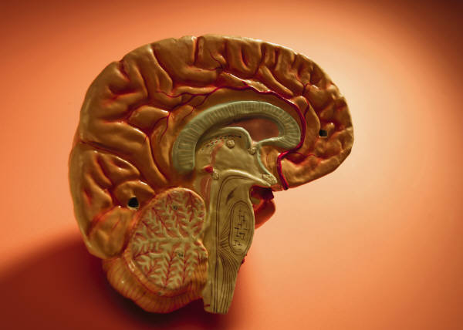
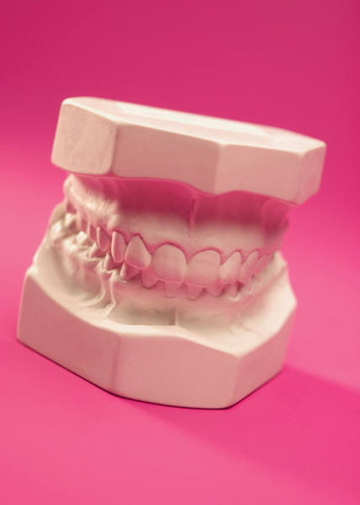
3D visuals:
Models : such as eyeball, rocket ship, etc.
Cutaways: models sliced in two

Slide 16
Audio:
Cd/mp3
Need to make sure it’s compatible
Needs to be loud enough to hear
Needs to be clear

Slide 17
Guidelines for visual aids
Large enough to be seen/loud enough to be heard
Does it enhance your speech/do you need it or not?
Don’t stand in front of it.
Talk to audience, not visual (*** lots did this before)
Keep out of sight until ready to use.

Slide 18
Cont’d
Don’t overdo a good thing
Have a backup plan: Murphy’s law==if something bad can happen, it will (be ready w/ backup just in case something won’t open!!!!)
Practice, practice, practice!

Slide 19
Section 4:

